Slide 1
OpenCV: Face Detection
Damola Adebayo

Slide 2
Artificial Intelligence
Artificial intelligence is the ability for machines to perform tasks that require a human level of intelligence
Computers are great at processing information
AI seeks to use that information to make smart decisions
AI should be able to rationalize and take actions that give it the best chance of achieving a specific goal

Slide 3
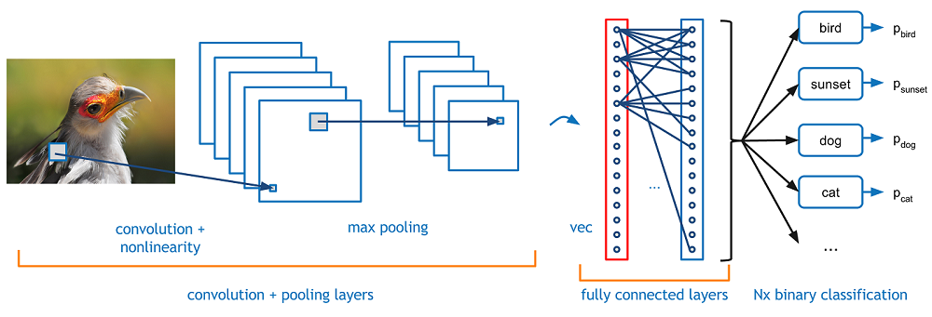
Convolutional Neural Network
A common method of achieving this task is building a model
A model that is used by a convolutional neural network that classifies objects in an image
A CNN is made up of layers of nodes
The feature map goes through convolution and pooling operations to extract features

Slide 4
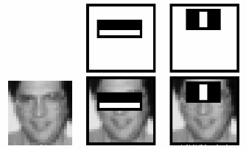
Integral Images
When computing features, it can help to apply filter matrices of varying sizes to the image
This however would take a lot of computation considering all the filter matrix sizes and their possible locations across the image
For each feature calculation, the sum of the pixels under white and black rectangles is required
To alleviate this computation, integral images are used
No matter how large your image is, it decreases the amount of computation for a specific pixel to an operation requiring only four pixels

Slide 5
AdaBoost
At the start of the process, each feature is given the same weight
After each classification attempt, the weights of incorrectly classified images are increased
We seek to dismiss the images we have performed well on and prioritize images that we have performed poorly on
Updated error rates and weights are calculated after each iteration
The process goes until we are content with accuracy of the algorithm

Slide 6
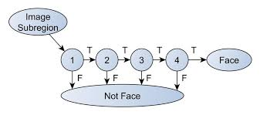
Cascade Classifiers
The final classifier is a weighted sum of the weak classifiers
One key observation about images is that most of the area in an image represents a nonface region
Features are assembled into groups that represent different stages of classifiers
In the case in which a image subregion fails, we throw it out
If it passes, we move on the next stage of features
If the image subregion passes all the stages, it is as a face region

Slide 7
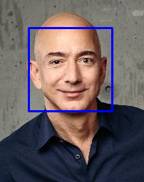
Method
OpenCV has a pretrained model for the cascade classifier
The cascade classifier is created
The model is loaded into the program to detect faces in an image with the XML file
The detection is done using the detectMultiScale() which creates a bounding box for the detected face

Slide 8
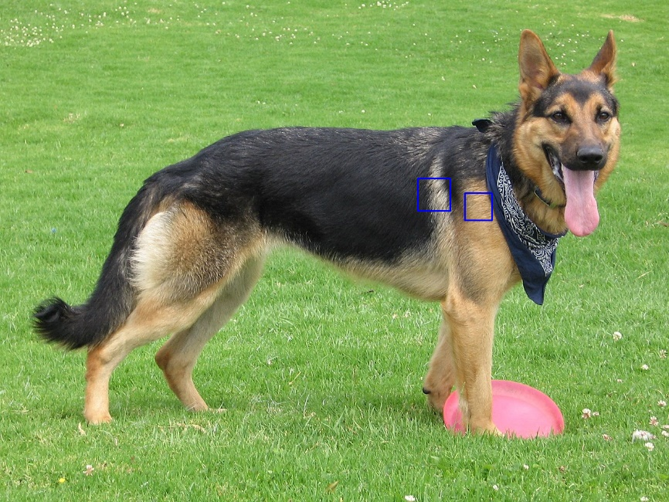
Future Goals
To detect faces in video
To classify the faces as specific people
To detect animal faces

